Slide 1

SEN 101
Introduction to Computing and Application
Lecture 9: Data structure
Ibrahim Abdullahi
Nile University of Nigeria, Abuja
Faculty of Natural and Applied Science Department of Software Engineering
© Adopted from Umar Adam Ibrahim

Slide 2
Content
Data structure
Data abstraction
Application of data structure
Choosing better data structure
2
© Umar Adam Ibrahim

Slide 3
Data Structures
A data structure is a scheme for organizing data in the memory of a computer.
Some of the more commonly used data structures include lists, arrays, stacks, queues, heaps, trees, and graphs.
The way in which the data is organized affects the performance of a program for different tasks.
Computer programmers decide which data structures to use based on the nature of the data and the processes that need to be performed on that data.
3
© Umar Adam Ibrahim

Slide 4
Con’t…
Why data structure?
To achieve that we need a storage
Data structures can be used to store data so that data can be used efficiently. The type of data structure to use depends on the problem at hand.
….
4
© Umar Adam Ibrahim

Slide 5
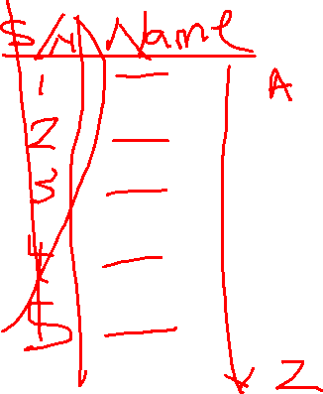
Linear data structure
Linear data is a collection of items arranged in sequential fashion.
5
© Umar Adam Ibrahim

Slide 6
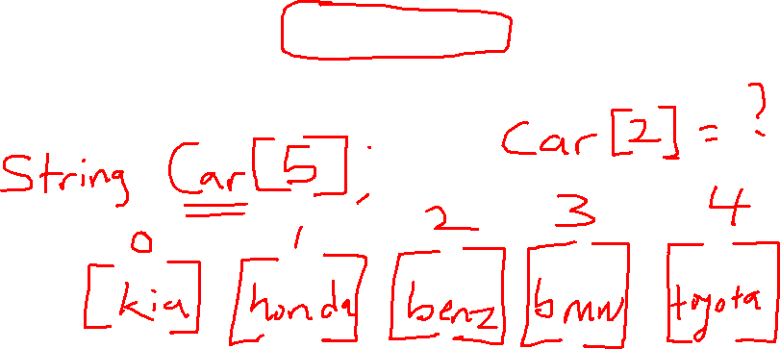
ARRAY STRUCTURE
Array is a collection of similar data elements described by a single name. each element of an Array is referenced by an index.
© Umar Adam Ibrahim

Slide 7
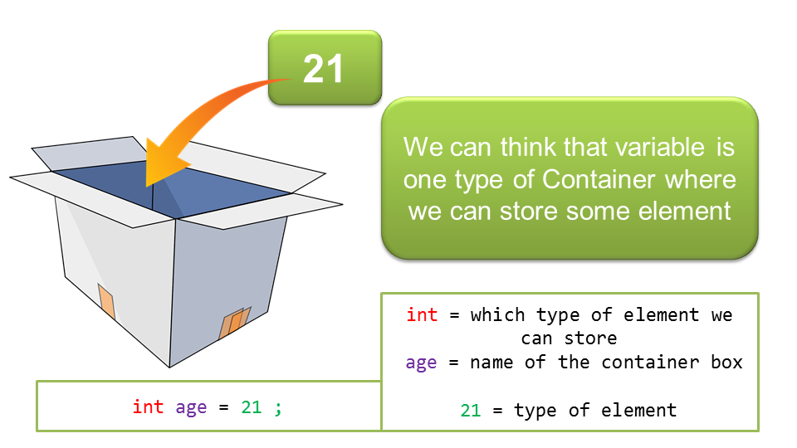
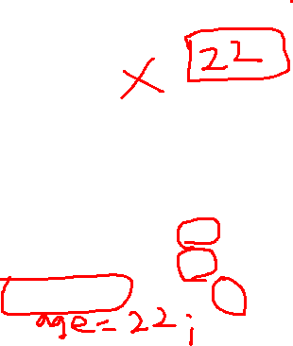
RECAP on variables
A variable is a memory that is used to hold/store a single value that can be used or modified by the program.
© Umar Adam Ibrahim

Slide 8
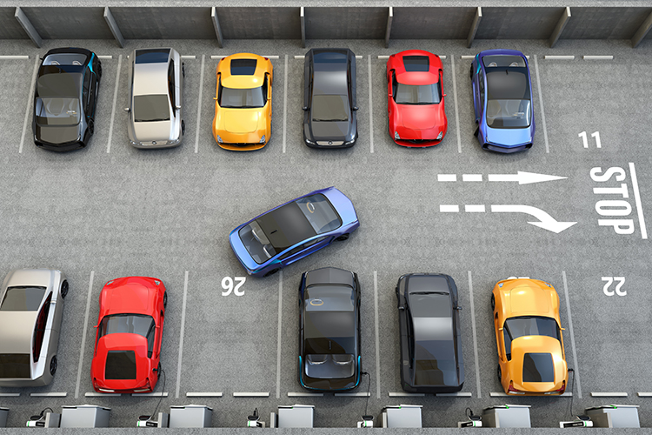
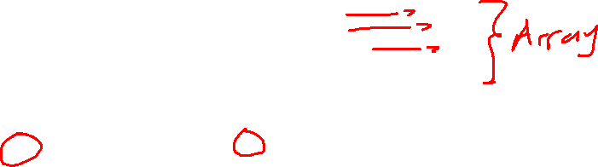
Array concept
Think of an Array as a Car Park
Nile University has 3 car parks with the name:
Park A
Park B
Park C
Variable name
Each of the car parks have
the maximum cars
it can take.
Size
Each parking slot can be reference
by a number
Index
Only vehicles are allowed
Data type
Each parking number has location
address
© Umar Adam Ibrahim

Slide 9
Array DECLARATION
Like any other variable, arrays must be declared before they are used. The general form of declaration is:
type variable-name [size];
int C [12];
By this declaration we are declaring a variable name C to be an Array, which can contain 12 integer values.
C[0] C[1] C[2] C[3] C[4] C[5] C[6] C[7] C[8] C[9]……..…….C[11]
5 | 10 | 8 | 2 | 9 | 2 | 1 | 0 | 5 | 2
© Umar Adam Ibrahim

Slide 10
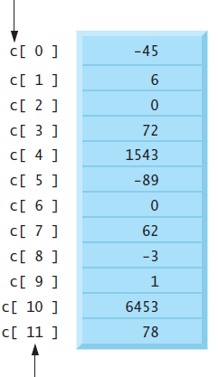
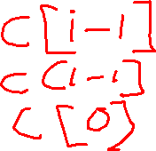
Array Structure
The first element in every array is the zeroth element. Thus, the first element of array C is referred to as C[0], the second element of array c is referred to as C[1], the seventh element of array c is referred to as C[6], and, in general, the ith element of array C is referred to as C[i - 1].
If an Array is referenced by a single index, the Array is also known as One dimensional Array.
© Umar Adam Ibrahim

Slide 11
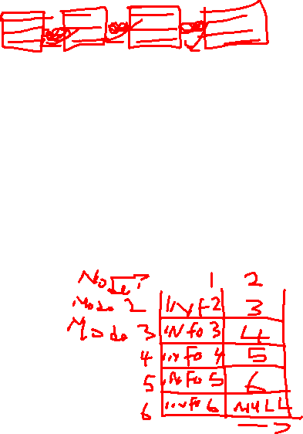
LINKED LIST
A Linked List is an ordered collection of finite homogeneous data elements called nodes, where the linear order is maintained by means of links or pointers. That is, each node is divided into two parts:
1. The first part contains the information (value) of the element.
2. The second part contains the address of the next node.
DATA
LINK
INFO
Link to the next node
© Umar Adam Ibrahim

Slide 12
Categories
Linked list are classified into three categories.
Linearly (Singly) linked list
Doubly Linked List
Circular Linked List
© Umar Adam Ibrahim

Slide 13
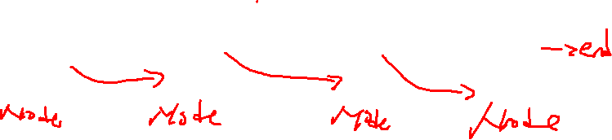
Linear linked structure
In linear linked list, each node is divided in two parts: First part contains the information of the element. And the second part contains the address of the next node in the list. That is each node has a single pointer to the next node, and in the last node case a null pointer represents the end of the end node.
INFO
LINK
20 | 1020
10 | 1131
45 | 1080
25 | NULL
FIRST
1010
1020
1131
1080
© Umar Adam Ibrahim

Slide 14
Circular linked structure
It is just like a linear linked list in which the second part of the last node contains the address of the first node in the list. i.e., the second field of the last node does not point to the NULL pointer rather it points back to the beginning of the linked list.
INFO
LINK
5 | 1020
10 | 1028
15 | 1039
20 | 1010
FIRST
1010
1020
1028
1039
© Umar Adam Ibrahim

Slide 15
DOUBLY linked structure
Doubly linked list are also called two-way lists. In the case of doubly linked list, two link fields are maintained instead of one as in linear linked list which helps in accessing both the successor and predecessor nodes.
PRE
INFO
SUC
NULL | 5 | 1020
1010 | 10 | 1028
1020 | 15 | 1039
1028 | 20 | NULL
FIRST
1010
1020
1028
1039
© Umar Adam Ibrahim

Slide 16
STACK STRUCTURE
A stack is an ordered collection of homogeneous (similar) data elements where the insertion and the deletion operations occur at only ONE end.
This end is often known as the TOP of the stack.
The last element inserted will be the first element to be removed out from the stack, that is why the stack is also commonly known as Last-in-First-out (LIFO). In another words we can say:
That the first element inserted will be the last element to be removed out from the stack, that is why we can also call it First-in-Last-out (FILO).
© Umar Adam Ibrahim

Slide 17
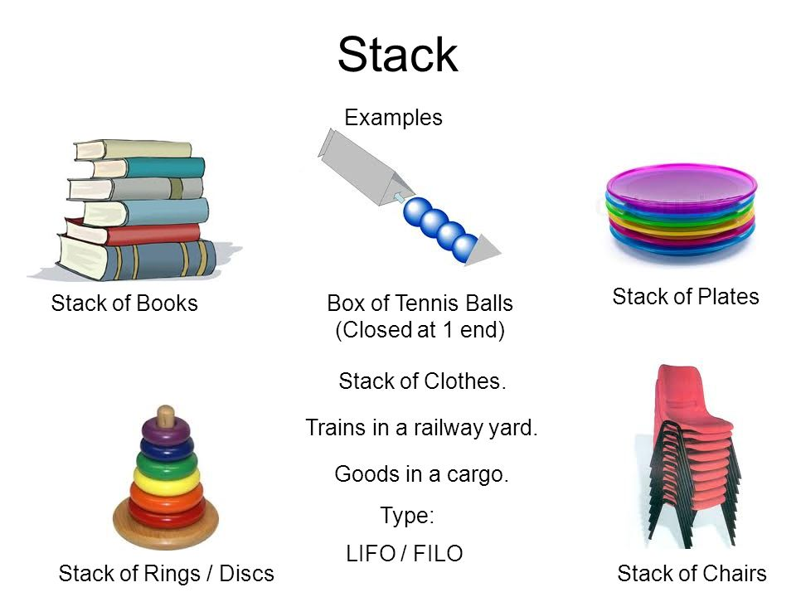
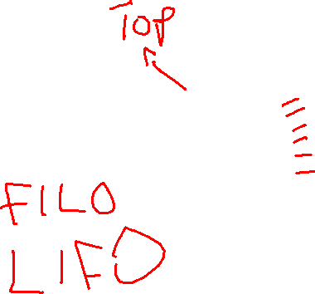
© Umar Adam Ibrahim

Slide 18

Operations on stack
Mainly the following three basic operations are performed in the stack:
Push(): Adds an item in the stack. If the stack is full, then it is said to be an Overflow condition.
Pop(): Removes an item from the stack. The items are popped in the reversed order in which they are pushed. If the stack is empty, then it is said to be an Underflow condition.
Peek() or Top(): Returns top element of stack.
isEmpty(): Returns true if stack is empty, else false.
© Umar Adam Ibrahim

Slide 19
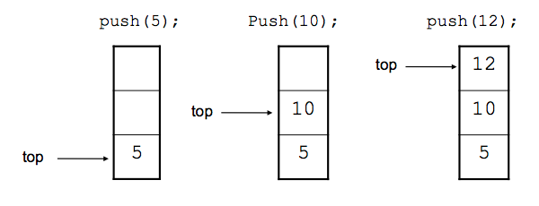
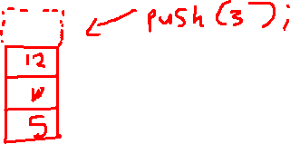
Push operations
The process of adding a new element to the top of the stack is called push operation. Pushing an element in the stack invoke adding element at the top.
In case of when trying to insert an element, but the stack becomes full. It is not possible. We call this situation stack overflow condition.
© Umar Adam Ibrahim

Slide 20
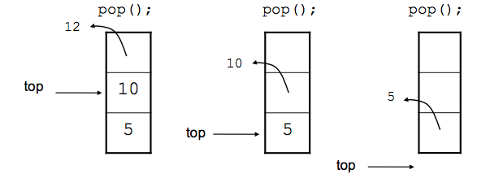
Pop operations
The process of deleting an element from the top of the stack is called pop operation. After every pop operation the stack is decremented by 1.
When all element are deleted, top points to bottom of the stack.
When stack is empty, it not possible to delete any element and this situation is called stack underflow condition.
© Umar Adam Ibrahim

Slide 21
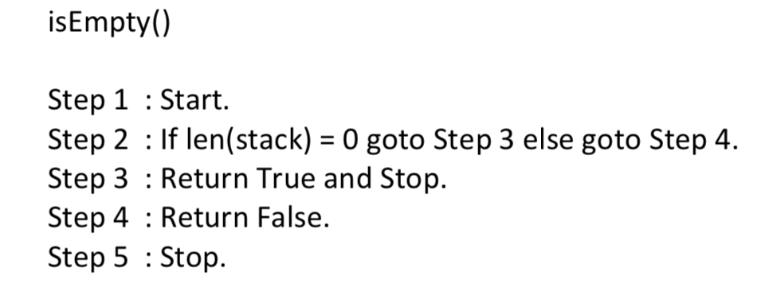
Is empty operation
Algorithm to check if the stack is empty
© Umar Adam Ibrahim

Slide 22
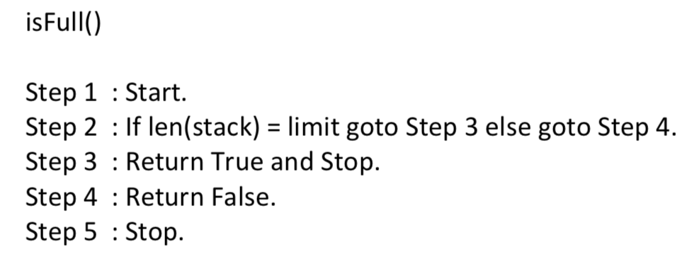
Is full operation
Algorithm to check if the stack is full
© Umar Adam Ibrahim

Slide 23
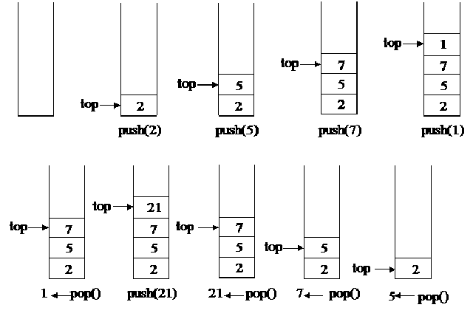
more example of stack
© Umar Adam Ibrahim

Slide 24
Stack applications
Checking the validity of arithmetic expressions.
Redo-undo features at many places like editors, Microsoft Word.
Forward and backward feature in web browsers.
Matching HTML and XML tags.
© Umar Adam Ibrahim

Slide 25
QUEUES STRUCTURE
Queues arise quite naturally in the computer for solution of many problems. Perhaps the most common occurrence of a queue in Computer Applications is for the scheduling of jobs.
The name ‘queue’ likely comes from the everyday use of the term. The real example of a queue is people standing in a queue for on an ATM.
The first person in the queue is the first person to get the service. Similarly the the first element inserted in the queue will be the first one that will be retrieved and hence a queue is also called the FIFO list
© Umar Adam Ibrahim

Slide 26
Queue is a linear list which has two ends, one for insertion of elements and the other for the deletion of elements. The first end is called REAR and the second is called the FRONT. Elements are inserted from the REAR-END and deleted from the Front end.
Insertion
Deletion
REAR
FRONT
© Umar Adam Ibrahim

Slide 27
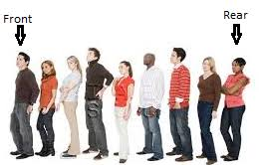
© Umar Adam Ibrahim

Slide 28
Queues
A queue is a waiting line that grows by adding elements to its end and shrinks by taking elements from its front
A queue is a structure in which both ends are used:
One for adding new elements
One for removing them
A queue is an FIFO structure: first in/first out
© Umar Adam Ibrahim

Slide 29
BASIC OPERATIONs
INSERT (or add) an element to the queue; push or enqueue
DELETE (or remove) an element from a queue; pop or dequeue
© Umar Adam Ibrahim

Slide 30
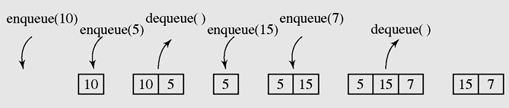
Queues (continued)
Figure 4-8 A series of operations executed on a queue
© Umar Adam Ibrahim

Slide 31
GENERAL Applications of queues
Some applications of queues are as follows:
1. There are several algorithm that use queues to solve problems easily, e.g. BFS, traversing of a binary tree.
Round-robin technique for processor scheduling is implemented using queues.
When the jobs are submitted to a networked printer, they are arranged in order of arrival. i.e Jobs sent to a printer are placed on a queue.
Every real-life line is a queue. For example, lines at ticket counters, filling stations or toll gates. Because the service is provided on first-come-first-serve. (FIFO) basis.
© Umar Adam Ibrahim

Slide 32
TREE STRUCTURE
A tree is a finite nonempty set of elements.
It is an abstract model of a hierarchical structure.
consists of nodes with a parent-child relation
© Umar Adam Ibrahim

Slide 33
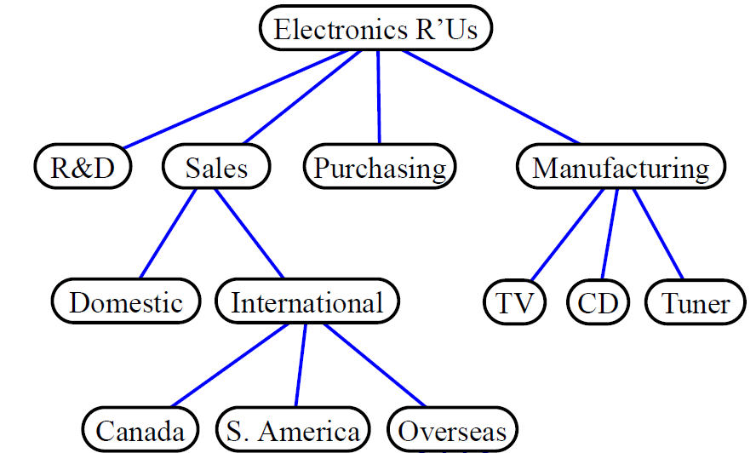
Trees Represent Hierarchy
© Umar Adam Ibrahim

Slide 34

Nature View of a Tree
leaves
branches
root
© Umar Adam Ibrahim

Slide 35

Computer Scientist’s View
root
leaves
branches
nodes
© Umar Adam Ibrahim

Slide 36
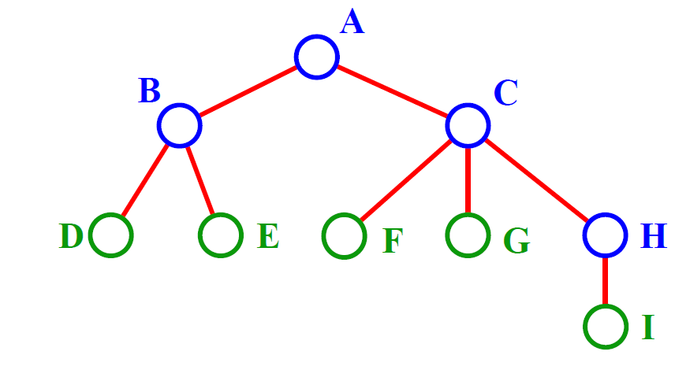
Terminology
© Umar Adam Ibrahim

Slide 37
A is the root node
B is Parent of D & E
A is Ancestor of D & E
D & E are descendants of A
C is the Sibling of B
D & E are the Children of B
D E F G I are external nodes or Leaves
A, B, C, H are internal nodes
© Umar Adam Ibrahim

Slide 38
Operations that can be performed
Creating a Binary Tree
If the number is greater, put it by the right
Else if number is less than, put it by the left
25 ,15, 50, 15, 10, 22, 35,70, 4 , 12 18, 24,31,44,66,90
© Umar Adam Ibrahim

Slide 39
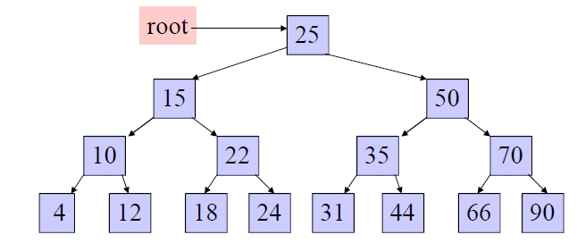
Solution
Search 44 , 50
© Umar Adam Ibrahim

Slide 40
Summary
Data structure
Array
Lindked List
Stack
Queue
Tree
40
© Umar Adam Ibrahim

Slide 41
Questions?
Thank you for coming.
41
© Umar Adam Ibrahim

